Slide 1

RAJALAKSHMI ENGINEERING COLLEGE
(AUTONOMOUS), CHENNAI
DEPARTMENT OF MECHANICAL ENGINEERING
GE23627– DESIGN THINKING AND INNOVATION
PROJECT TITLE:IOT-Enabled Smart Gas Detection and Autonomous Shut-off System
STUDENTS:
ARAVIND B (231101011)
KANISHK H (231101036)
DAVIS ROWAN V (231101016)
57
BATCH NO:
GUIDED BY:
SHANKAR E
AOP
PROJECT PRESENTATION – ZEROTH / FIRST /SECOND / THIRD / FINAL REVIEW
Venue: Department Of Mechanical Engineering, REC
Date:27/01/2026

Slide 2
PRESENTATION OUTLINE
1. | Problem Definition (4)
2. | EMPATHIZE : (5)
3. | Problem Context & Background (6)
4. | Literature Survey & Field Study (7)
5. | DEFINE : (9)
6. | Structured Problem Definition (10)
7. | User Persona & Journey (slide no. ……..)
8. | IDEATE: (slide no. ………)
9. | Ideation & Concept Generation (slide no..)
10. | Concept Selection (slide no. ……….)
11. | PROTOTYPE: (slide no. ……………..)
12. | Methodology / Workflow Chart (slide no. 15)
13. | Modelling (slide no..)
14. | Design (slide no. 15)
15. | Materials & Process Selection (slide no..)
16. | Bill of Materials (slide no..)
17. | Fabrication / Implementation (slide no..)
18. | TEST: (slide no..)
19. | Testing & Validation (slide no..)
20. | RESULTS & CONCLUSION: (slide no..)
21 | Project Outcomes Expected (slide no..)
22. | Project Expenditure Statement (slide no..)
23. | Project Time Utilization (slide no..)
24. | Acknowledgement (slide no..)

Slide 3
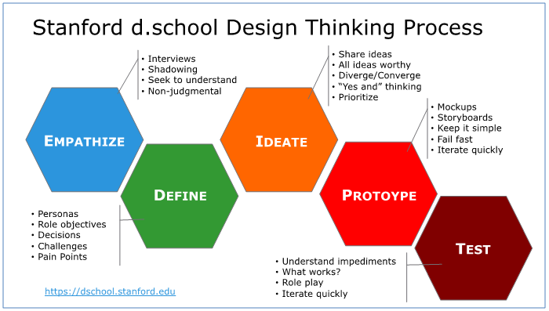
DESIGN THINKING STEPS

Slide 4
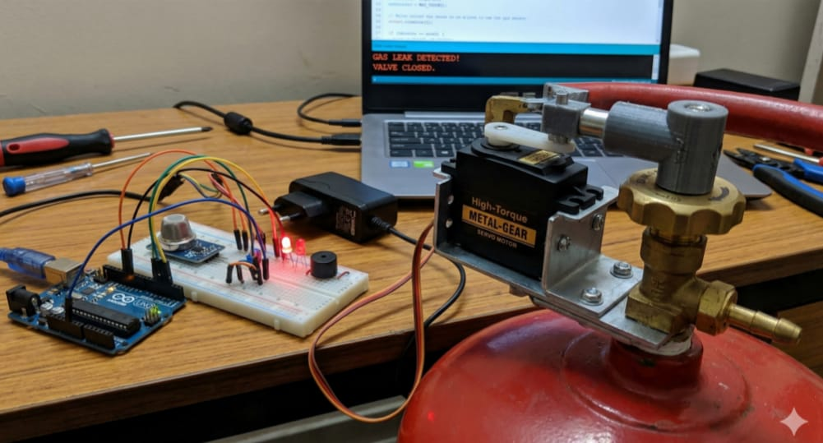
Problem Definition
IOT-Enabled Smart Gas Detection and Autonomous Shut-off System
LPG gas leakage is a common safety issue in Indian households and commercial kitchens
Gas leaks are often detected late as users rely mainly on smell
Panic situations lead to delayed manual gas shut-off
Existing gas detectors mostly provide only alarms without automatic control
Elderly people, children, and absent users are highly vulnerable
Gas leakage accidents can cause fire, explosion, suffocation, and property damage
There is a lack of affordable, automatic, and reliable gas safety systems
BATCH 57 / IOT-Enabled Smart Gas Detection and Autonomous Shut-off System

Slide 5
1. EMPATHIZE
Project Title: IOT-Enabled Smart Gas Detection and Autonomous Shut-off System
Empathy is the ability to understand and share the feelings of another person. In this project, empathy helps us understand the fear, anxiety, and safety concerns faced by users during gas leakage incidents in homes and workplaces.
Persona | Demographics | Goals | Frustrations | Behaviors
Lakshmi, Homemaker | 45-year-old homemaker, lives in urban Chennai, uses LPG daily for cooking | Safe cooking environment, protect family from accidents | Fear of gas leaks at night, delayed detection, manual shut-off during panic | Relies on smell to detect leaks, opens windows, turns off regulator manually
Ramesh, Working Professional | 38-year-old office employee, lives with family, away from home during daytime | Ensure family safety even when he is not at home | Worry about gas leaks when house is unattended, no remote alerts | Checks stove before leaving, depends on family members for safety
Suresh, Restaurant Staff | 30-year-old cook in a small restaurant, handles multiple gas stoves daily | Prevent fire accidents, uninterrupted cooking operations | High pressure during peak hours, delayed response to leaks | Focuses on cooking tasks, ignores minor smells, reacts only when alarms sound
57/ IOT-Enabled Smart Gas Detection and Autonomous Shut-off System

Slide 6
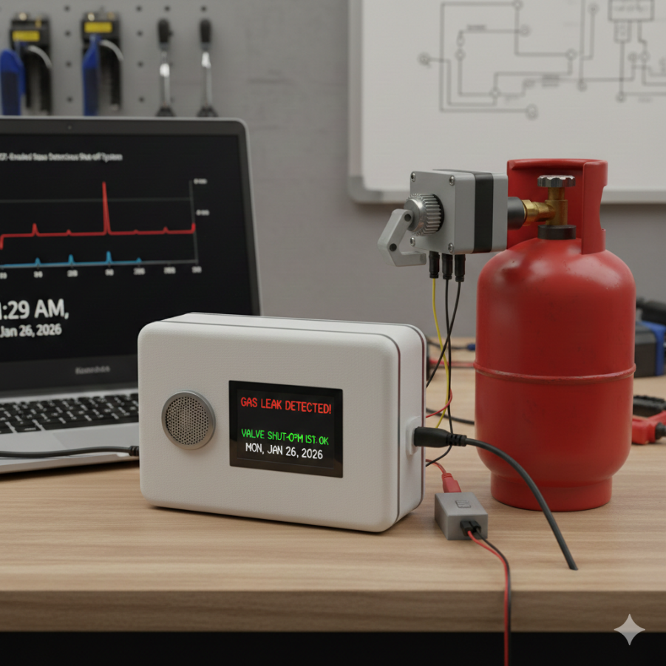
1. EMPATHIZE - Problem Context & Background
LPG gas cylinders are widely used in Indian households, restaurants, and small commercial kitchens
Gas leakage can occur due to loose regulators, worn-out rubber hoses, improper installation, or human error
Most users depend only on smell to detect gas leaks, which is unreliable during sleep or absence
Leakage incidents often create panic, leading to delayed or incorrect actions
Elderly people, children, and kitchen workers are highly vulnerable during gas leakage situations
Manual gas shut-off is difficult during emergencies or when users are not present
Existing gas detectors mainly provide sound alarms without taking preventive action
Lack of automatic shut-off increases the risk of fire, explosion, suffocation, and property damage
Users desire a system that works automatically, without requiring technical knowledge
Safety concerns cause constant anxiety and reduce user confidence during daily cooking activities
57/ IOT-Enabled Smart Gas Detection and Autonomous Shut-off System

Slide 7
1. EMPATHIZE - Literature Survey & Field Study
S.No. | Title of the paper | Journal citation | Inference
1 | IoT Based Gas Leakage Detection and Alert System | International Journal of Engineering Research & Technology (IJERT) | Gas sensors integrated with IoT can detect LPG leakage early and send alerts to users, improving safety
2 | Smart Gas Leakage Monitoring System Using Arduino | International Journal of Scientific Research in Computer Science Engineering (IJSRCSE) | Automatic gas detection reduces dependency on human senses like smell
3 | Automatic Gas Shut-Off System for Domestic Safety | International Journal of Advanced Research in Electrical, Electronics and Instrumentation Engineering (IJAREEIE) | Autonomous shut-off mechanisms significantly reduce accident severity during leakage
4 | LPG Gas Leakage Detection and Prevention System | IEEE International Conference on Smart Systems | Real-time monitoring and control improve response time during emergencies
5 | IoT-Based Home Safety and Gas Monitoring System | International Journal of Innovative Technology and Exploring Engineering (IJITEE) | Combining detection, alert, and control ensures comprehensive household safety
57/ IOT-Enabled Smart Gas Detection and Autonomous Shut-off System

Slide 8
1. EMPATHIZE - FIELD STUDY & PRIOT ART SEARCH (Patent Search)
Key Insights
Gas leakage incidents are often detected late due to reliance on human senses
Panic situations lead to delayed or incorrect responses
Manual gas shut-off is not reliable during emergencies or absence
Existing systems lack preventive action, offering only alarms
Users desire automatic safety solutions without technical complexity
Opportunity Areas
Real-time gas leakage detection without human intervention
Automatic gas shut-off to prevent escalation of accidents
Remote alerts to inform users even when they are away
Affordable and easy-to-install solution for households and small kitchens
User-friendly system requiring minimal maintenance
57/ IOT-Enabled Smart Gas Detection and Autonomous Shut-off System

Slide 9
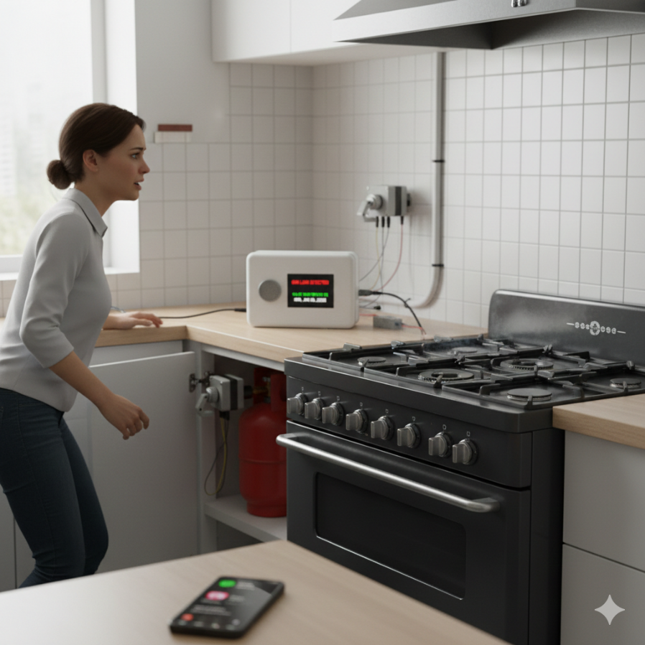
2. DEFINE
Problem Analysis & Need Identification
Insights from the empathize stage were analyzed to identify the core user problem
Gas leakage incidents are unpredictable and require immediate action
Human-dependent detection and response are slow and unreliable
Delay in shutting off gas supply increases risk of fire and explosion
Existing solutions lack automation and remote monitoring
Users need a system that works continuously without supervision
Safety solutions must be affordable, reliable, and easy to use
The problem is clearly defined to guide focused ideation and solution development
57/ IOT-Enabled Smart Gas Detection and Autonomous Shut-off System

Slide 10
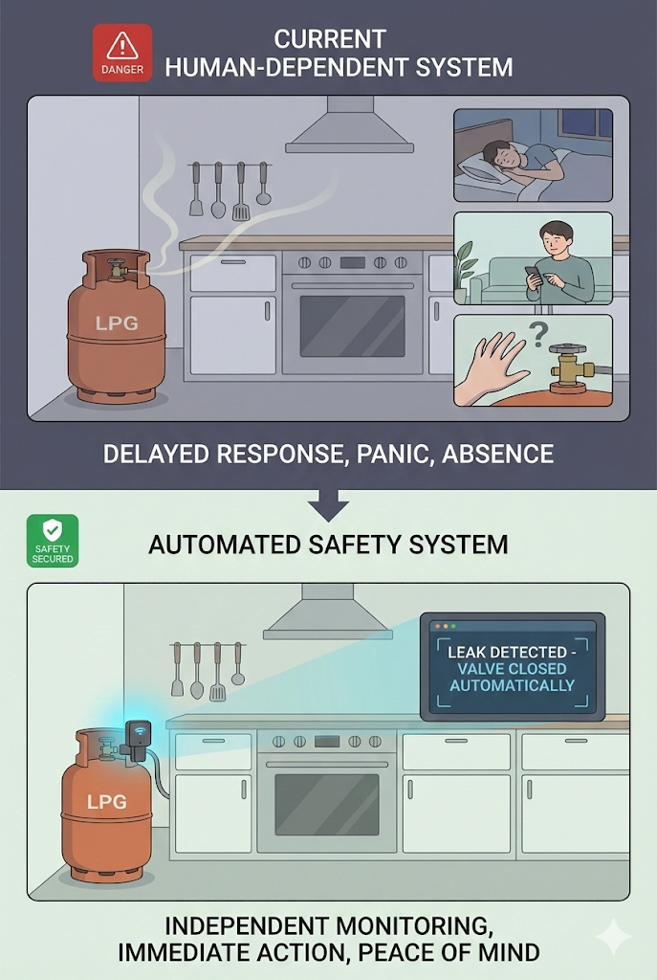
2. DEFINE - Structured Problem Definition
Users of LPG gas cylinders in households and small commercial kitchens face a significant safety risk due to delayed, incorrect, or ineffective response during gas leakage incidents. Gas leakage events are sudden, unpredictable, and often occur when users are unprepared, distracted, asleep, or not physically present near the cylinder.
Existing gas safety systems primarily depend on human detection through smell or alarm alerts and require manual intervention to shut off the gas supply. By eliminating dependence on human intervention, such a system can significantly reduce accident severity, improve household and workplace safety, and provide users with confidence and peace of mind during daily gas usage.
57/ Project Title

Slide 11
2. DEFINE - User Persona & Journey
User Persona
User Type: Household LPG user / Small commercial kitchen operator
Age Group: 25–65 years
Technical Skill: Low to moderate
Primary Concerns: Family/workplace safety, fire risk, safety during absence
Pain Points: Panic during gas leakage, fear of approaching cylinder, difficulty in manual valve closure
Current User Journey (Problem Scenario)
Gas leakage occurs unexpectedly
Leakage detected late through smell or alarm
User panics or hesitates
Manual valve shut-off is delayed or not performed
Gas accumulates, increasing accident risk
57/ Project Title

Slide 12
3. IDEATE - Ideation & Concept Generation
57/ Project Title

Slide 13
3. IDEATE - Concept Selection
57/ Project Title

Slide 14
4. PROTOTYPE
57/ Project Title

Slide 15
4. PROTOTYPE - Methodology / Workflow Chart
57/ Project Title

Slide 16
4. PROTOTYPE - Modelling
57/ Project Title

Slide 17
4. PROTOTYPE - Design
57/ Project Title

Slide 18
4. PROTOTYPE – Materials, Parts & Process Selection
57/ Project Title

Slide 19
4. PROTOTYPE - BoM
COMPONENT | Specification | QUANTITY
57/ Project Title

Slide 20
4. PROTOTYPE – Fabrication / Implementation
57/ Project Title

Slide 21
5. TEST – Testing & Validation
57/ Project Title

Slide 22
5. TEST – RESULTS & CONCLUSION
57/ Project Title

Slide 23
Project Outcomes Expected
57/ Project Title

Slide 24
Works to be done
Patent application
Journal publication
Conference presentation
57/ Project Title

Slide 25
PROJECT EXPENDITURE STATEMENT
Sl. No. | Activity | Expenditure amount (Rs.)
1 | Material /components purchase
2 | Fabrication /experiment
3 | Testing /characterization
4 | Project outcome activity expenditure (attending conferences, technical event, etc…)
5 | Miscellaneous
 | Total cost
57/ Project Title

Slide 26
TIME UTILIZATION (MONTHLY REPORT)
 | 1-15 Jan 2026 | 16-31 Jan 2026 | 1-15 Feb 2026 | 16-28 Feb 2026 | 1-15 Mar 2026 | 16-31 Mar 2026 | 1-15 Apr 2026 | 16-30 Apr 2026 | Apr. 2023
1. Selection of guide, topic.
2. Problem identified.
3. Literature survey
4. Design and drawing |  | .
5. Material /component purchase
6. Fabrication /experiment
7. Testing /characterization
8. Thesis writing
9. PPT /project outcome preparation
10. Final review attending

Slide 27
ACKNOWLEDGEMENT
57/ Project Title

Slide 28



